Slide 1

Thermal Transfer Measurements Made With the
Transient Line Heat Source Method
With Information on Phase Change Materials
Geoffrey Brown, Product Manager
METER Group Inc. USA

Slide 2
Support from:
Dr. Gaylon Campbell and
Dr. Doug Cobos

Slide 3
Decagon Devices, Inc.
(Pullman, WA, USA)
+
UMS Ag
(Munich, Germany)
=
METER Group

Slide 4

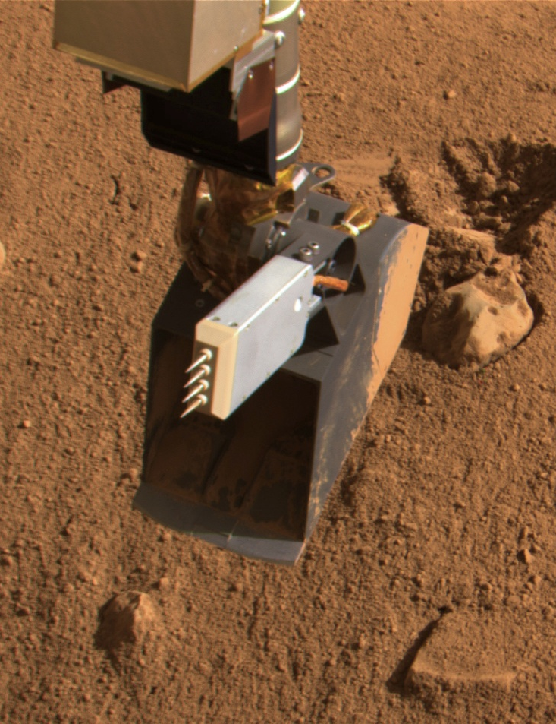
Phoenix Scout Mission to Mars June 25, 2008 – Oct., 2008
TECP: Thermal and electrical properties probe
Notes:
The TECP probe was developed by Decagon in conjunction with Jet Propulsion Laboratories, in California. Our sensors were mounted on a long arm scoop that collected samples of Martian regolith. As the arm reached out for samples the sensor was stuck into the surface to take measurements before that sample area was collected by the scoop. The main purpose of the sensor was to measure the thermal and electrical properties of the martial regolith to infer liquid water content, ice content, and pore size distribution. The probe also contained a wind speed sensor and humidity sensor. All of these parts worked correctly and thermal data of the regolith was collected.

Slide 5
Interesting Direct Applications
Artificial skin
Corneas
Nanofluids
Heat loss from buried power cables
Cooking and sterilizing of foods
Oils and coolants
Greases and heat sink compounds
Polymers
Notes:
While the thermal sensors Decagon uses were designed for soil testing they can be used in any application where the probe itself has proper contact with the sample. For example, one might wonder how corneas could be measured with a probe type sensor. The user took multiple cornea and stacked them onto the probe to create a proper sample size and contact. This type of probe is also a good choice for testing in liquids that are less viscous than water, and I will touch a little more on that later.

Slide 6
Outline
Steady state conductivity measurement
Line heat source conductivity measurement
Improvements to the line heat source method
Phase change materials testing
  Gels and liquids
Notes:
This is the basic outline of the topics I will cover. We will first discuss the steady state conductivity method with its advantages and downfalls. Then the line heat source method with its advantages and shortcomings. I’ll make note of some improvements we are making to the current device. This new version is being developed now, and I have a prototype with me. Finally I’ll present how the line heat source method can be used for Phase Change Materials testing with some results from testing we did in house on some gels and liquids.

Slide 7
Steady State Thermal Conductivity
Measure heat flux density, H, temperatures and thickness
Compute K from:
H
T₁
T₂
Δx
Notes:
In this process a known amount of heat is applied to one side of the sample . Temperature is monitored on either side of the sample. Once the temperature on the “cold” side of the sample reaches equilibrium with the “hot side” we calculate for conductivity, considering the thickness of the sample.
There is no way to contain the heat flow from exiting the sides of the sample unless a guarded hot plate is being used.

Slide 8

Radial Test Cell For Steady State Thermal Conductivity
Heater &
Temp. sensor
Soil in
Copper or
Aluminum
tube
r₁ heater radius
r₂ tube radius
T₁ heater temp.
T₂ tube temp.
q heat per unit length
Temp.
sensor
Insulation
Notes:
Using a cylindrical sample shape and applying heat at the center can limit the escaping heat. Some sort of insulation would be needed to “guard the heat from escaping.
Again, to calculate for conductivity with this configuration one measures the heat being applied, the thickness of the sample, and the temperature at the outside of the cylinder.

Slide 9
Steady State Methods for Determining k
Good
Simple calculations
Large samples
Direct method
Bad
Heat divergence
Large samples
Laboratory method
Slow
Thermally induced moisture redistribution
Home made and/or expensive
Notes:
The positives of the steady state method are that calculations are relatively simple, we can use large samples to get real world results, and this technique is a direct method.
Again, we can lose heat out the edges of the sample unless precautions are taken (guarded hot plate method). Large samples are sometimes not available, or material cannot be spared. This is typically a lab method and that can limit the types of materials to be tested.
Measurements take a long period of time, hours if not days.
A guarded hot plate usually costs over 12,000 even if it is “home made”.

Slide 10
Consequences of Thermally Induced Water Flow
Steady state methods work well for measuring thermal conductivity in the laboratory on saturated or completely dry materials
Steady state methods don't work for measuring thermal conductivity of unsaturated porous media
Notes:
A major fault of this test type is thermally induced water flow. If a sample is completely dry or saturated thermally induced water flow is not an issue. However, when a sample is sort of dry the long heat times will move moisture in the sample. This will give false readings and result in bad data. Steady state methods does not work well with damp samples.
The line heat source method is better for slightly dry samples.

Slide 11
Line heat Source Methods for Thermal Properties
Place a line heat source in the sample
Apply heat to the source and measure its temperature over time
Compare the measured response with the response predicted using the Fourier law model
adjust k and D in the model until it matches the measurements
Notes:
Similar to the radial steady state setup the line source is placed in the sample. The heat is applied and the temperature change is measured over time. There are no need for guards or plates.
The differences in the equations comes when the measured response is compared with the predicted response using the Fourier Law model.

Slide 12
Equations for Line Heat Source Measurements
During heating
After heating
Notes:
Delta T is equal to q (heat put into the needle) over 4pi times k. Ei is the exponential integral, we multiply that by –r² (probe radius) over 4 times diffusivity times time.
This is the model we use to generate data to compare values. These are the solutions to the differential equations from Fourier’s model that describe the heating and cooling.

Slide 13
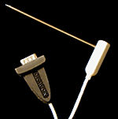
Thermal Conductivity: Single Needle Method
Notes:
When we put heat into the needle and only look at that heat being applied the slope is straight and directly proportional to the samples resistivity.
Typically those are simplified and we plot the temp against the log of time. Resistivity is directly proportional to the slope of the line.

Slide 14
Why is the response linear with In t?
Notes:
Because time is in the denominator the bigger t (time) gets the smaller a (__) gets. Over time a gets smaller and smaller and can eventually be ignored. At this point only the first two terms of this equation need to be considered.

Slide 15
Pulsed Infinite Line Source, Approximate Solution
Notes:
This shows the real data of temperature applied against the log of time, producing a straight line.

Slide 16
Example of k measurement
Notes:
You can plot log t for the heating or plot log t/t-t_{o} for cooling. The difference of p (resistivity)=153 C cm/W on the heating line and p (resistivity)= 144 C cm/W for the cooling line is a drift in the temp reading. When we take an average of the two slopes we get the usable number.

Slide 17
Heated Needle as Transient Line Heat Source
Ideally
Source is infinitely long and infinitesimally small
Medium is uniform
Temperature is uniform and constant
Source is in intimate contact with medium

Slide 18
Heated Needle as Transient Line Heat Source Reality:
Source is 10cm long and 2.4 mm in diameter
Temperature may vary in space and time
Contact resistance between source and medium can occur
Medium may not be uniform (no control)
Notes:
This slide represents the issues with the heated needle as transient line heat source.
Error is low on the smaller needle while the larger needle has higher error. Longer read times can reduce error.
The larger needles are used more widely for application in soil because the IEEE standard call for the 2.4 mm needle.

Slide 19
Transient Methods for Determining k
Good
Small or large samples
Fast
Portable
No thermally induced water flow
In situ measurements
Bad
Destructive

Slide 20
Improvements on the Transient Method
Blackwell solution to the differential equation
Takes into account the finite probe size
Takes into account contact resistance
Other improvements
Monitors temperature drift and correct the data
Notes:
The new device monitors for any drift over 0.002 ºC a second. A test won’t start until the drift slows or the user manually continues.

Slide 21
Thermal Dryout Curves
The relationship between thermal conductivity and water content for a soil or other porous material
Water content is an important variable, but density, mineralogy and temperature are also important. These need to be held constant
Notes:
The relationship between the thermal conductivity or resistivity and the water content can provide a dryout curve. The single needles can be used directly in a drying oven to get the thermal measurement as the sample dries, with the device set in continuous measurement mode.
A user can test the sample in its “as found” condition then saturate the sample, take weights, and dry the sample.

Slide 22
Dryout Curve of Sand
Notes:
Here is an example of a dryout curve. Having the “as found” information of the sample can improve the analysis of the curve.
I can provide more information on dryout curves if anyone is interested.

Slide 23
General PCM Info
Transient line method can be used in liquids, solids, and gels.
Sensors can be used in an environmental chamber
Lab tech saves time with continuous read mode
Notes:
The transient line method is a good choice for phase change materials that are solid, gel, or liquids. Liquids need to be as viscous as water or less viscous than water. If a sample is more viscous than water it is hard to control movement of the sample by induced convection.

Slide 24
Experiment in PCMs
Tested liquids and gels
Green product phase change occurs at 5 ºC
Orange product phase change occurs at 15 ºC
Gel samples retain shape at warmer temperatures
Notes:
We tested two different products that were in both liquid and gelled forms, 4 samples total.
The phase change of the green product occurs at or around 5 C in both the liquid and gel.
The phase change is around 15 C in the orange gel and liquid.

Slide 25
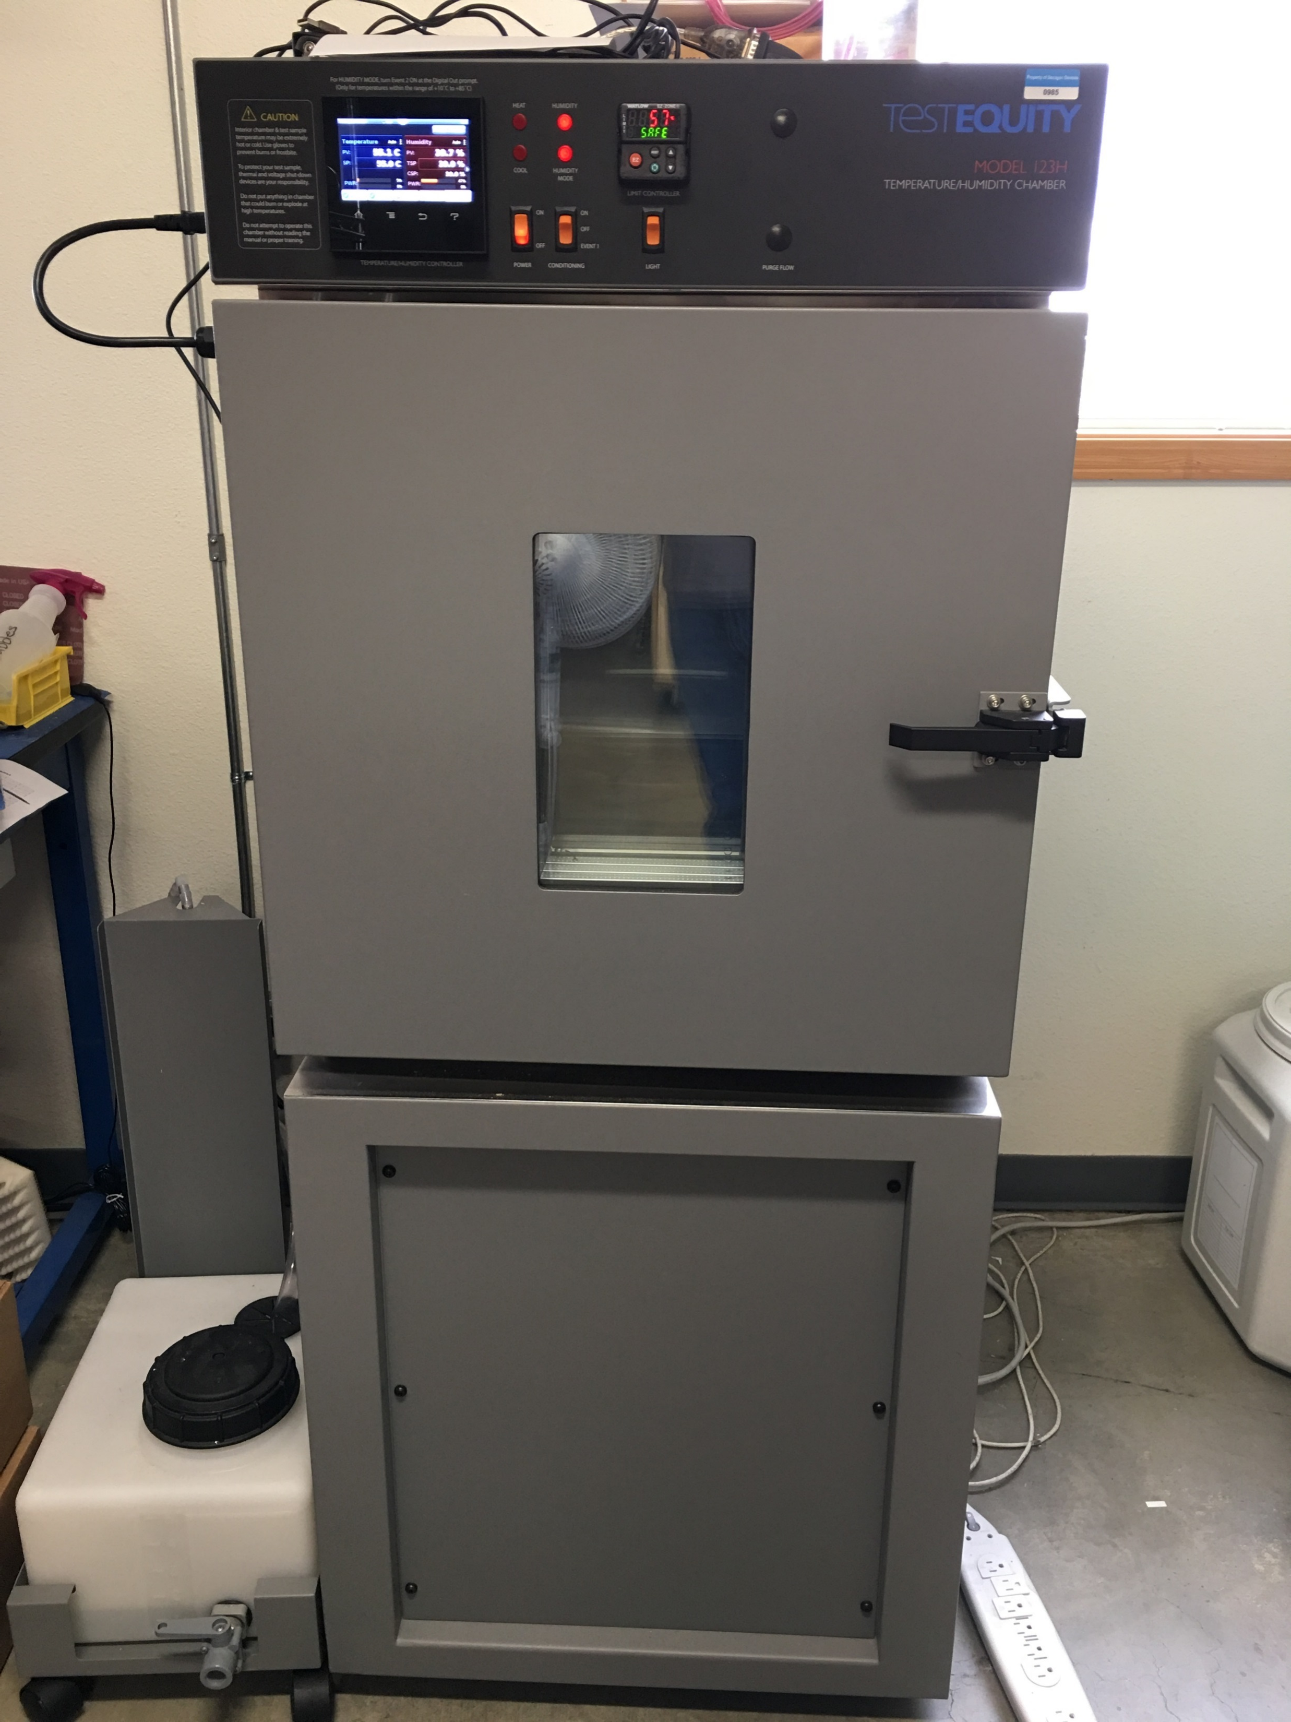
Test Setup
Needle inserted into the gel and placed in an environmental chamber.
Liquid samples placed in vial and thermal needle probe inserted into vial via septa in lid.
Needles in vertical orientation
Notes:
Samples were placed in the environmental chamber. The test started once the chamber reached -30 C. At this point the samples are all frozen and in a solid phase. The chamber was preprogrammed to raise temperature slightly over time. Testing took about 24 hours to complete for each sample. The thermal testing unit or KD2Pro was set to continuous measurement mode and readings were taken every 15 minutes with the KS-1 needle probe.

Slide 26
Results of 5ºC Materials
Notes:
The liquid sample and gel sample in the 5 ºC both begin their phase change at the same temperature as indicated by the rise in thermal conductivity. It also appears the thermal conductivity of the frozen samples are the same, whether liquid or gel.
The conductivities above freezing for the liquid are higher than they should be because of induced convection caused by vibrations in the environmental chamber. We made a measurement at room temperature outside the chamber, and it was similar to the gel value.
The rise in conductivity is actually a false spike and should only be considered an apparent thermal conductivity. We are not exactly sure why the spike occurs. We think it is the needle getting various temp readings at the solid pieces transform, not providing a uniform testing area. This theory is derived from the higher spike in the liquid compared to the lower spike in the gel which retains its gel form at room temperature.

Slide 27
Results of 17ºC Materials
Notes:
The first observation is that liquid samples are affected by the vibrations of the environmental chamber at after the phase change at higher temperatures. Like the previous sample the 17 C samples were measured at room temperature after testing and conductivities were acceptable.
In this material the starting conductivities for the liquid and gel are slightly different, we don’t really know why. Though, the phase change appears to occur at the same temperature.
Another interesting note is the 17 C gel has a higher conductivity than the 5 C gel and liquid but the 17 C liquid had a lower conductivity than the 5 C gel and liquid. This is odd because they are presumably made from the same ingredients but at different quantities.

Slide 28
Conclusion
Steady state method is simple, but has flaws that can result in bad data
Transient line source solves for some of those faults
We are making improvements to make it even better
Transient line method works well in PCMs

